Slide 1

Lazar Milicevic
Joining the Infrastructure Platform Team

Slide 2

About Me
I have
10+ years
of experience in automation, DevOps, and IT service
management
Background in
Python, JavaScript, Azure, and cloud computing
I'm not the expert in the room, I'm a tech enthusiast eager to learn from all of you! I believe in solving problems creatively and am not afraid to tackle any task, no matter how challenging. ☺
Education
• Bachelor of Science in Computer Engineering
Key Skills:
• University "Dositej", Belgrade
Scripting and automation in Python
• "Python for Artificial Intelligence"
Experience with large-scale server environments (2000+ servers)
• "JavaScript Programming Course"
Cloud & Virtualization: Azure, AWS, VMware ESX
• Qubes IT School
Infrastructure & Security: Networking, VPNs, Firewalls
Recent Roles:
•
Owkin
- Customer Success Manager (Jan 2025 - Present)
• Gategroup - IT Workplace L2 Engineer (Feb 2023 - Dec 2024)
• Customer Success Management - Senior IT Engineer (Jan 2022 - Jan 2023)
• Smart Electronics Store - Software Engineer (Jan 2022 - Jan 2023)

Slide 3




My Journey at Owkin
Since joining Owkin as a
Customer Success Manager
in January 2025, I've found myself naturally drawn to support-related
tasks and opportunities for improvement.
While my primary role focuses on customer relationships, I've always seen myself as a
bridge between product teams and
engineers
, understanding the language and needs of both worlds. ☺
I believe in taking initiative where I see potential to contribute more.
The following projects weren't part of my official Customer Success role, but personal initiatives where I identified opportunities to help our teams and company succeed.
Zendesk ↔ AWS Integration
ZMD Script Generator
Cognito → PostHog Backfill
Automated two-way ticket synchronization
Automated analytics for K-Navigator signups
Historical data migration for OKR tracking

Slide 4
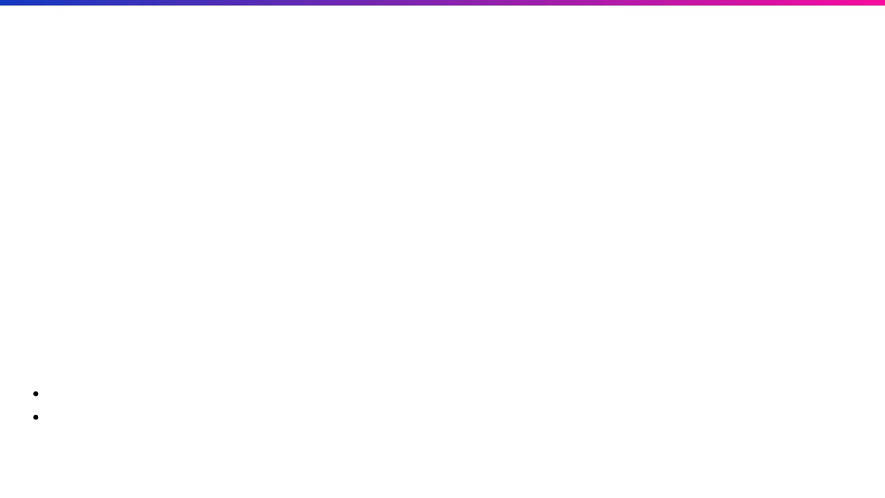
Zendesk ↔ AWS Case Integration
Problem:
No seamless communication between Zendesk tickets and AWS Support cases
Solution:
Two-way integration using AWS Lambda and EventBridge:
Zendesk → AWS: Create/update AWS Support cases
AWS → Zendesk: Sync updates back to Zendesk
Technologies:
AWS Lambda
EventBridge
Python
Zendesk API
Outcome:
Innovative solution
- no existing documentation
Completed in just
2 weeks
Eliminated manual cross-platform management

Slide 5
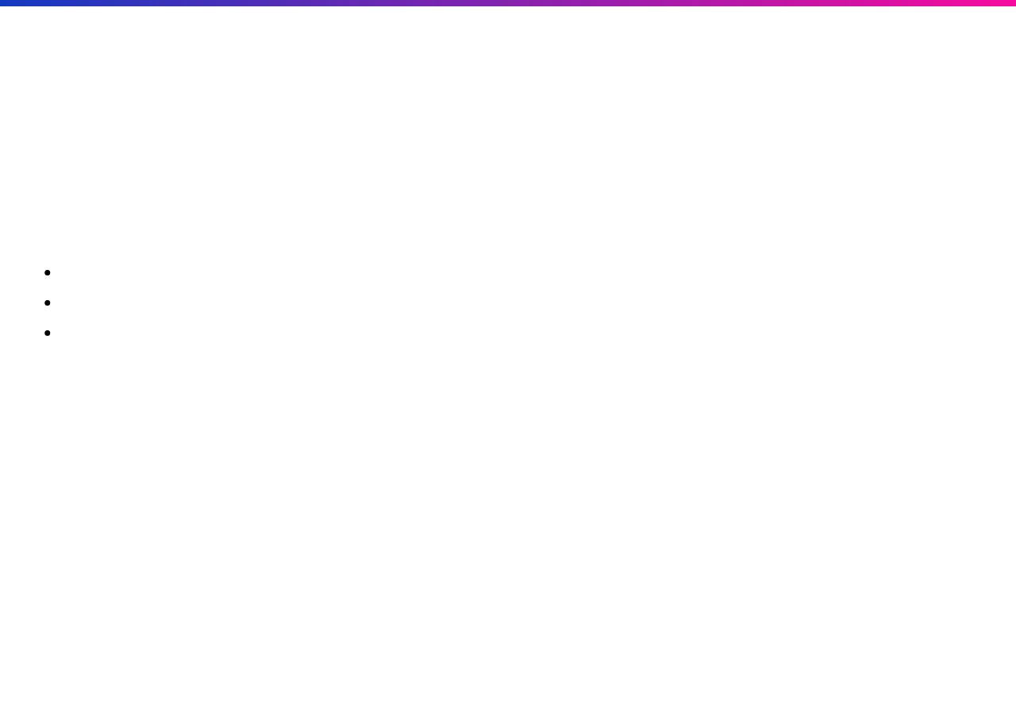
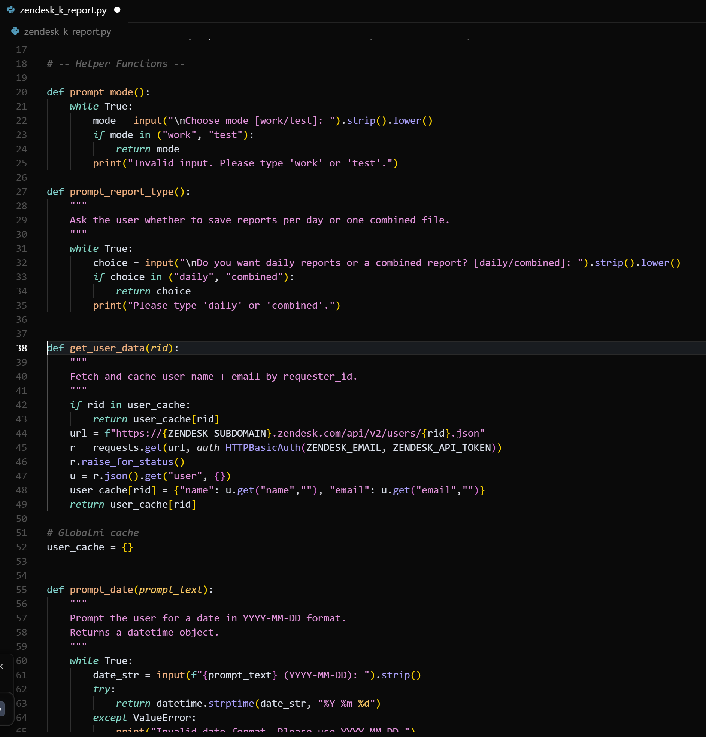
Zendesk Reports Generator (K-Navigator)
Purpose:
Automated generation of reports concerning K-Navigator signup requests during the manual approval process period.
Implementation:
Python script for
daily extraction
of Zendesk ticket data
Ran continuously for
3+ months
Generated
90+ analytical reports
All reports stored in a centralized Google Drive repository
Key Metrics Tracked:
Tickets created, solved, approved, rejected
Owkin vs. non-Owkin user distribution
Average resolution time
Potential competitors and high-value leads
Business Impact:
Saved
~45 hours
of manual work (30 min/day × 90 days)
Enabled product team to focus on analysis rather than data gathering

Slide 6

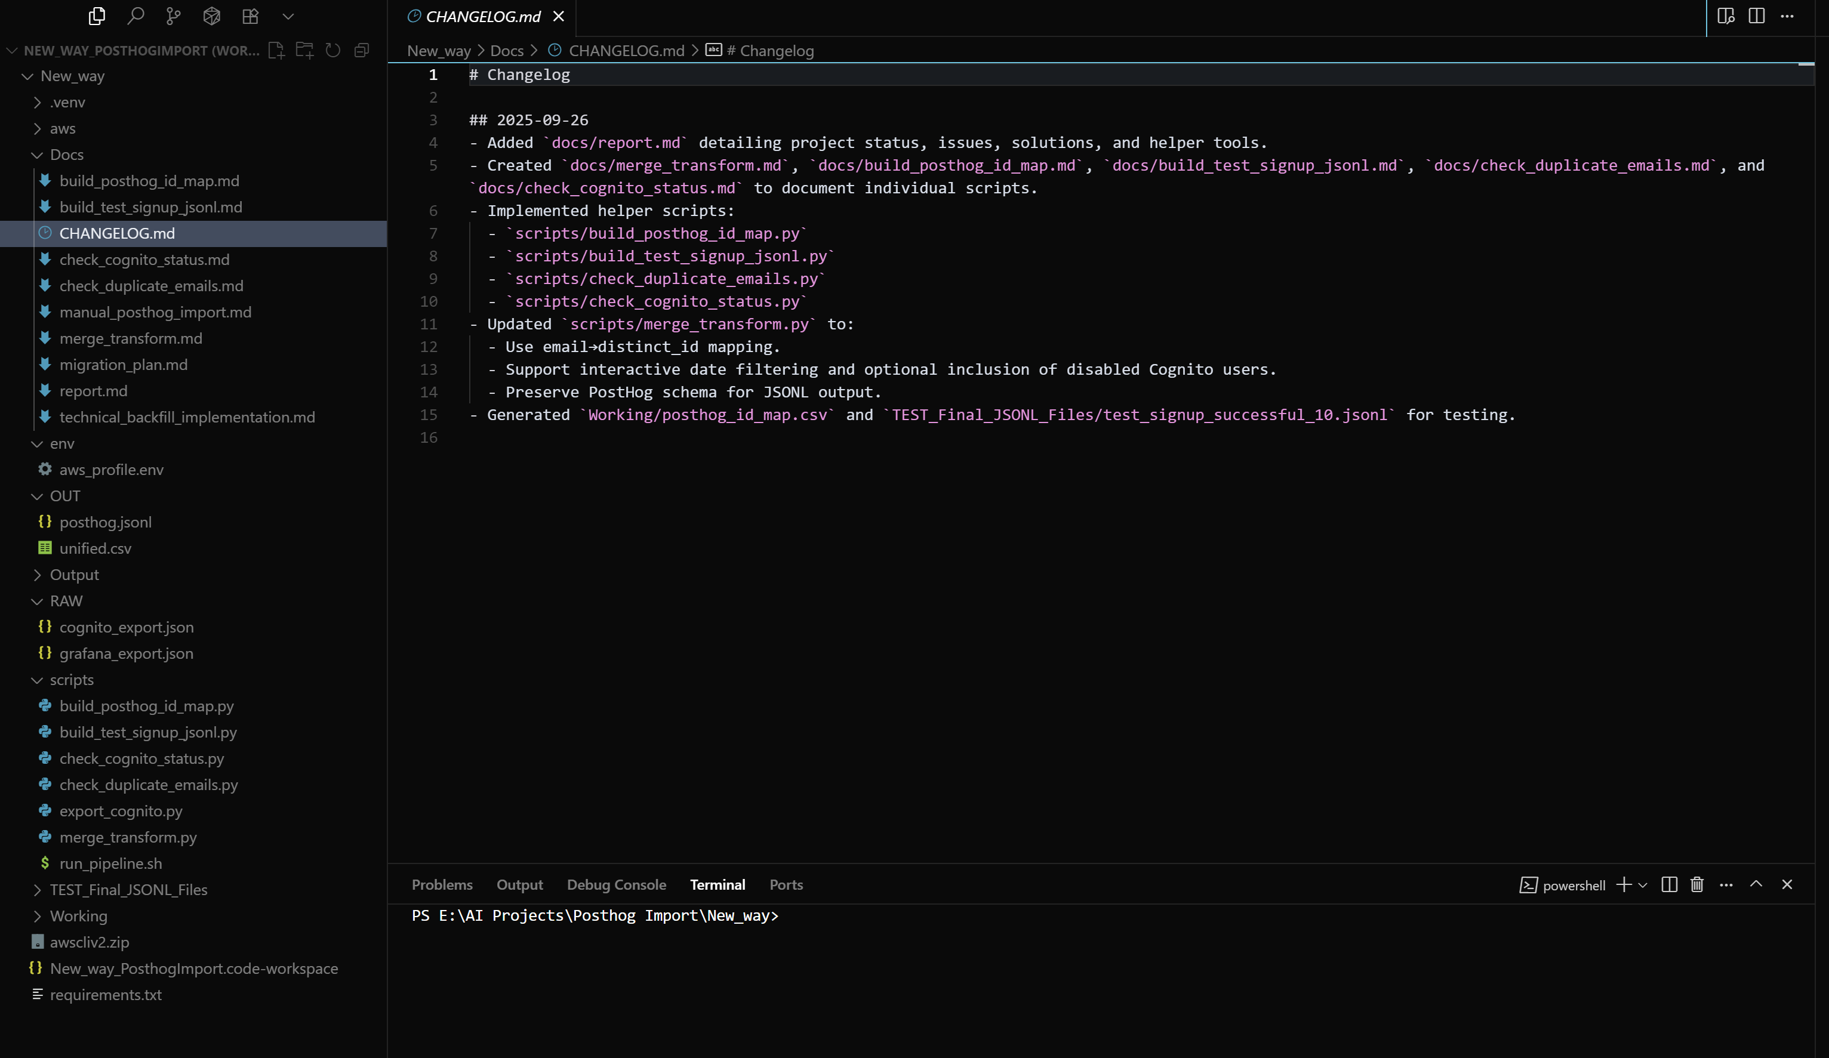
Cognito → PostHog Backfill Project
Need:
PostHog was implemented after K-Navigator's launch, missing historical user data and activities. This project backfills that data to enable PostHog to serve as the
single source of truth
Technical Challenges:
JSON → JSONL transformation for PostHog import
Identity mapping to prevent duplicate users
CloudTrail access for confirmation timestamps
Cross-platform compatibility (Windows/Linux)
Solution:
Built end-to-end Python pipeline for:
Cognito user export with all attributes
Current Status
Email → PostHog distinct_id mapping
Data merging, transformation, validation
10-user test successfully validated in Posthog dev
S3 bucket and IAM setup complete
S3 managed migration to PostHog
Pending:
Technologies:
CloudTrail permissions for confirmation timestamps
Ready for production import once permissions granted
Python
AWS Cognito
PostHog
CloudTrail
S3

Slide 7
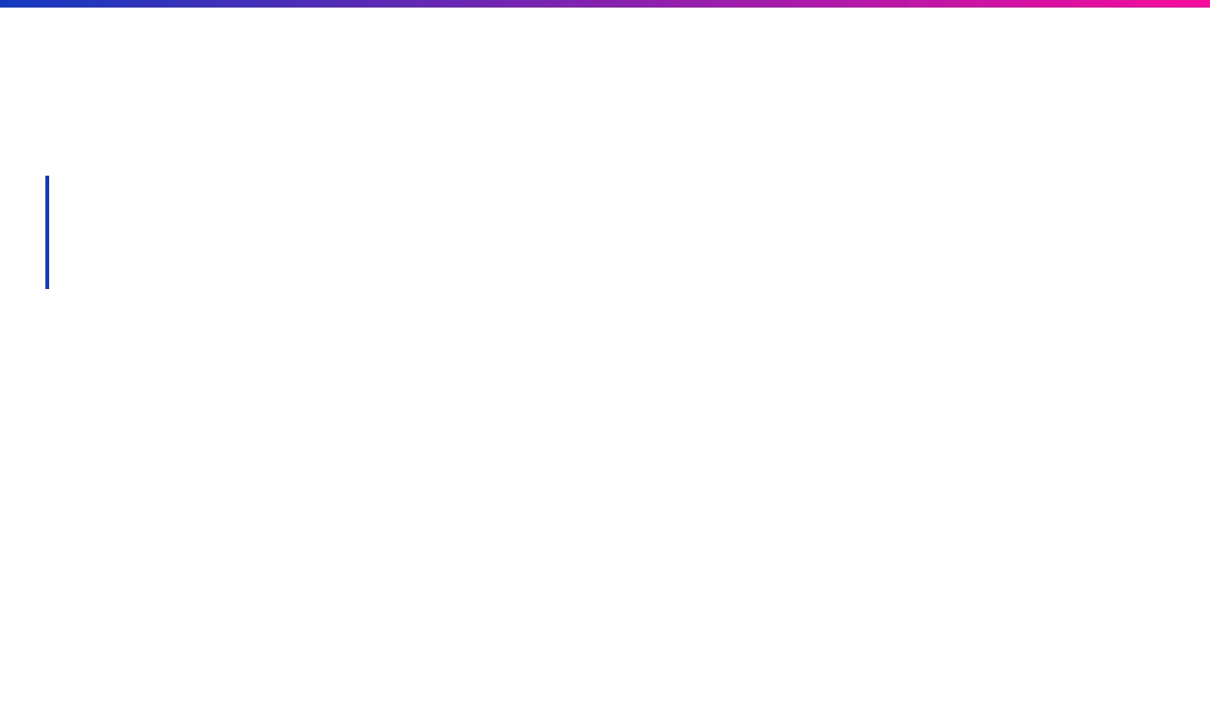



Next Steps & Transition
Pending Tasks:
CloudTrail Permissions
Need
cloudtrail:LookupEvents
permissions to complete
the Cognito → PostHog backfill project with confirmation
timestamps
My Approach:
I'm excited to join a team of experts and am ready to:
Take on tasks that help the team focus on higher priorities ☺
Learn from the collective expertise in the room
Contribute with my automation and scripting experience
Let's Connect:
Feel free to book 1:1 meetings in my calendar
I'm looking forward to collaborating with each of you

